Slide 1
Club Officer TRAINING
Distinguished Club Program (DCP)
&
Club Success Plan (CSP)
Wes Johnson, DTM,IPDD & Joey Waldrop, DTM, PDG
206FP

Slide 2
Session Agenda
Moments of Truth
Distinguished Club Program
Club Success Plan
1

Slide 3
Session Objectives
Describe Moments of Truth
Describe the Distinguished Club Program
Describe importance of club success plan
Encourage all officers to participate in completing a Club Success Plan
2

Slide 4
Moments of Truth
First Impressions
Membership Orientation
Fellowship, Variety, and Communication
Program Planning and Meeting Organization
Membership Strength
Achievement Recognition
Moments of Truth (Item 290)
Toastmasters.org/290
3

Slide 5
Qualifying Requirements
Distinguished Club Program Qualifier
Membership of 20 or a net growth of five or more new members as of June 30, 2021
Membership base is number of members on July 1, 2020
Net Growth is Club membership increase between July 1, 2020 & June 30, 2021
4

Slide 6
DCP Education Goals
Education
1. Four Level 1 awards achieved
2. Two Level 2 awards achieved
3. Two more Level 2 awards achieved
4. Two Level 3 awards achieved
5. One Level 4, Level 5, or DTM award achieved
6. One more Level 4, Level 5, or DTM award achieved
Distinguished Club Program & Club Success Plan
toastmasters.org/1111_dcp
7

Slide 7
Remaining DCP Goals
Membership
7. Four new members
8. Four more new members
Training
9. Minimum of four club officers trained during each of two training periods
Administration
10. One membership dues-renewal report and one club officer list submitted on time
Distinguished Club Program & Club Success Plan
toastmasters.org/1111_dcp
7

Slide 8
Distinguished Club Program
Distinguished, Select Distinguished, President’s Distinguished
Distinguished Club Program & Club Success Plan
toastmasters.org/1111_dcp
8

Slide 9
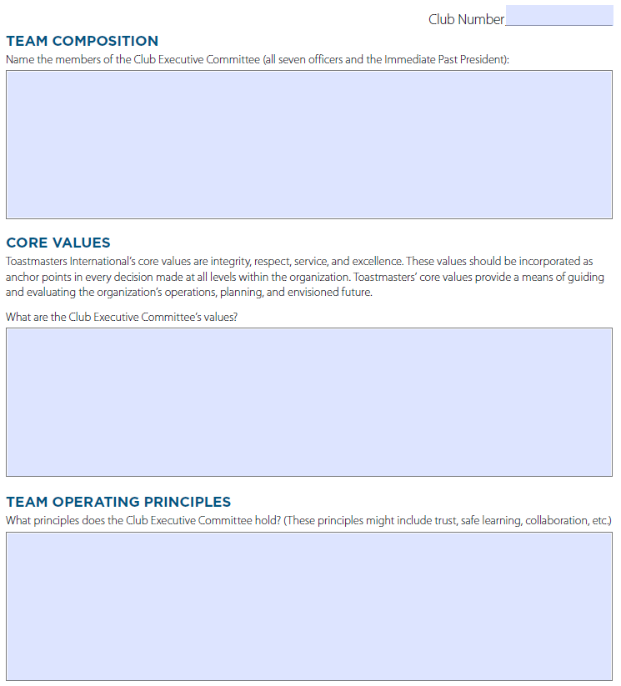
Club Success Plan
18 pages
➔ 1 - 3) Who we are
4) Qualifying Requirement
5) State of your club
6 - 8) Education Action Plan
9 -11) Membership Goals
12-14) Training
15-17) Administration
18) Commitment Signatures
Distinguished Club Program & Club Success Plan
toastmasters.org/1111_dcp
21

Slide 10
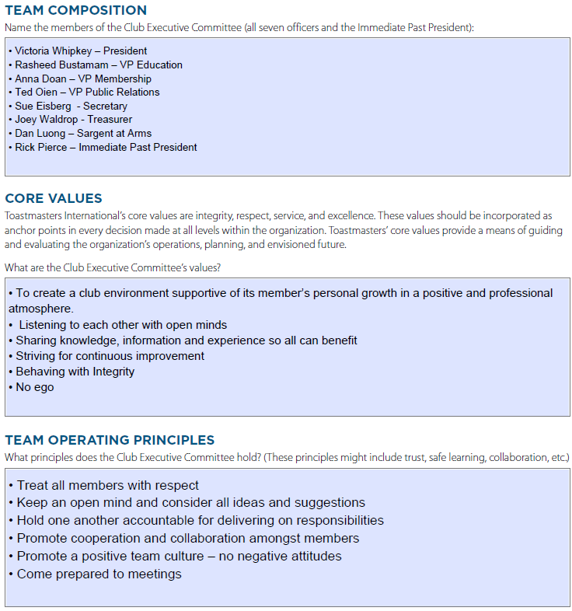
Club Success Plan – Page 1
18 pages
➔ 1 - 3) Who we are
4) Qualifying Requirement
5) State of your club
6 - 8) Education Action Plan
9 -11) Membership Goals
12-14) Training
15-17) Administration
18) Commitment Signatures
Distinguished Club Program & Club Success Plan
toastmasters.org/1111_dcp
21

Slide 11
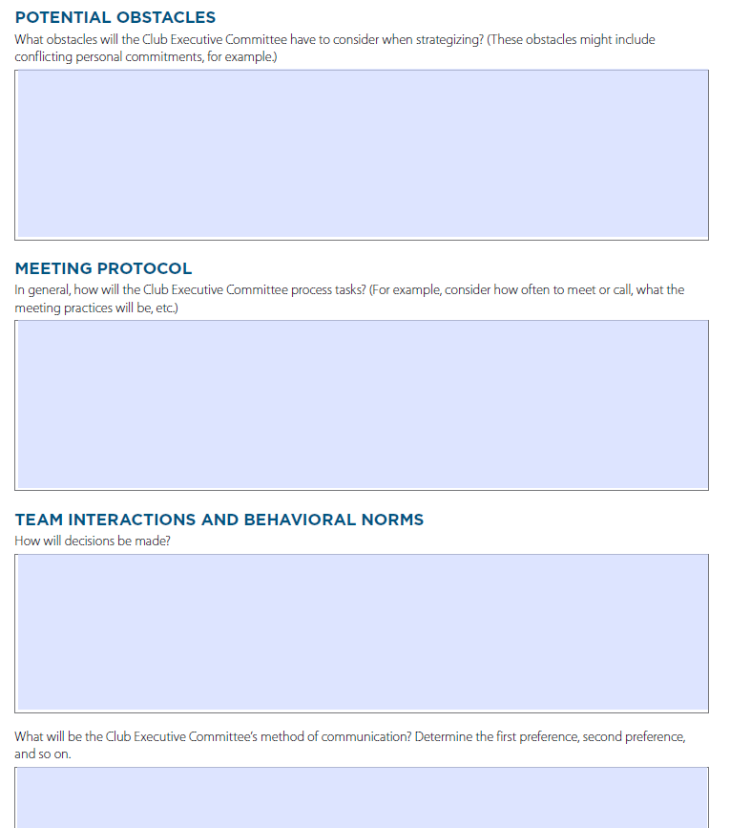
Club Success Plan – Page 2
18 pages
➔ 1 - 3) Who we are
4) Qualifying Requirement
5) State of your club
6 - 8) Education Action Plan
9 -11) Membership Goals
12-14) Training
15-17) Administration
18) Commitment Signatures
Distinguished Club Program & Club Success Plan
toastmasters.org/1111_dcp
21

Slide 12
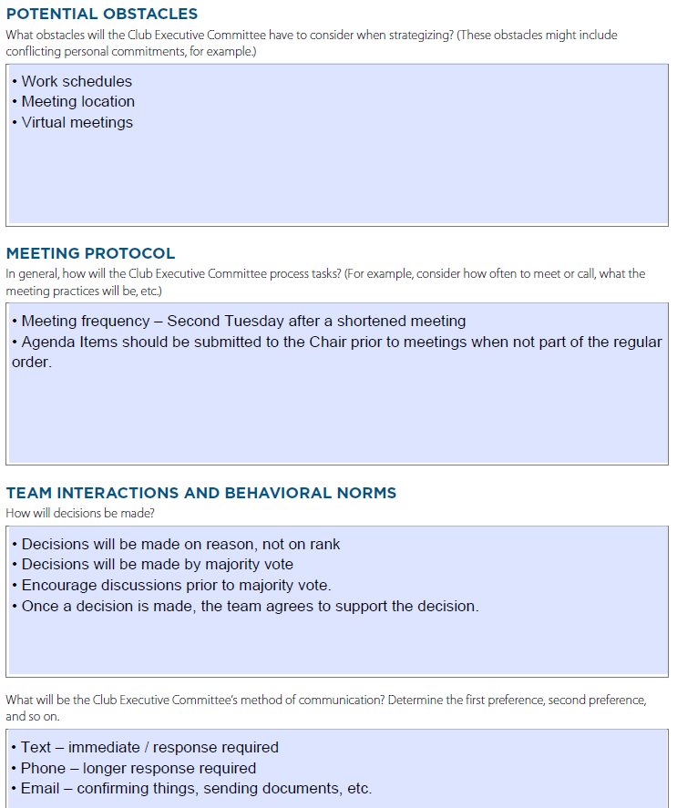
Club Success Plan – Page 2
18 pages
➔ 1 - 3) Who we are
4) Qualifying Requirement
5) State of your club
6 - 8) Education Action Plan
9 -11) Membership Goals
12-14) Training
15-17) Administration
18) Commitment Signatures
Distinguished Club Program & Club Success Plan
toastmasters.org/1111_dcp
21

Slide 13
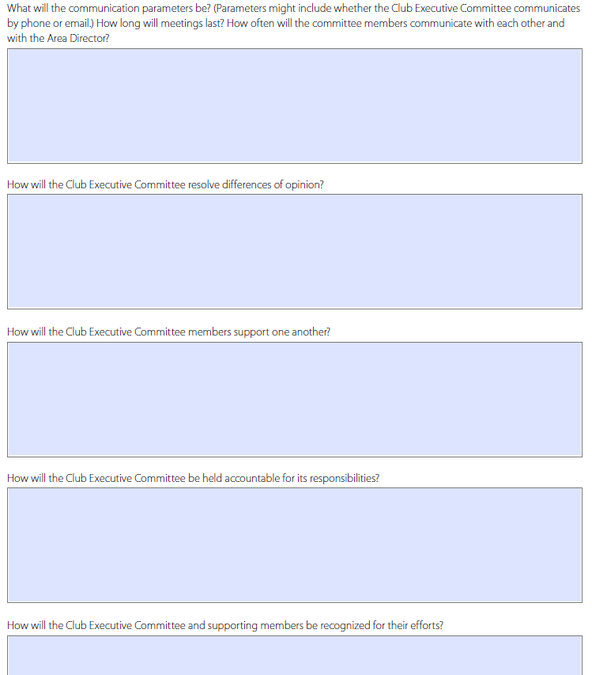
Club Success Plan – Page 3
18 pages
➔ 1 - 3) Who we are
4) Qualifying Requirement
5) State of your club
6 - 8) Education Action Plan
9 -11) Membership Goals
12-14) Training
15-17) Administration
18) Commitment Signatures
Distinguished Club Program & Club Success Plan
toastmasters.org/1111_dcp
21

Slide 14
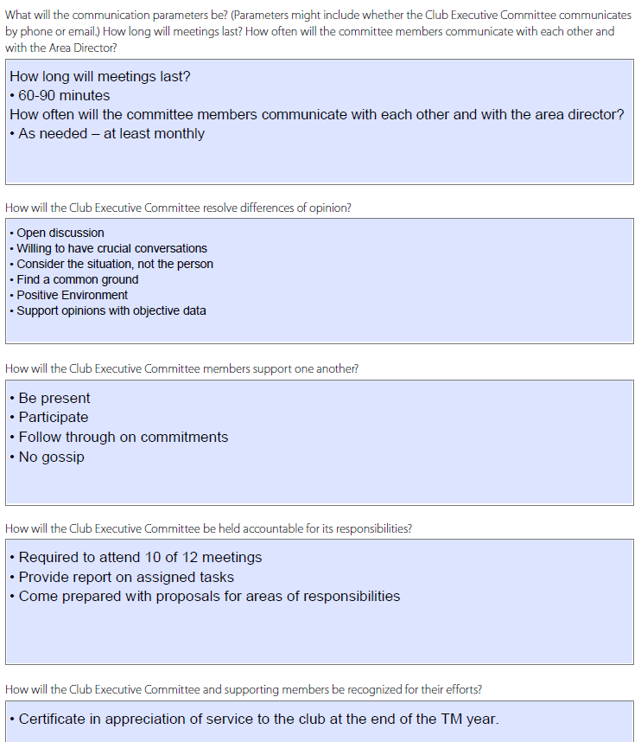
Club Success Plan – Page 3
18 pages
➔ 1 - 3) Who we are
4) Qualifying Requirement
5) State of your club
6 - 8) Education Action Plan
9 -11) Membership Goals
12-14) Training
15-17) Administration
18) Commitment Signatures
Distinguished Club Program & Club Success Plan
toastmasters.org/1111_dcp
21

Slide 15
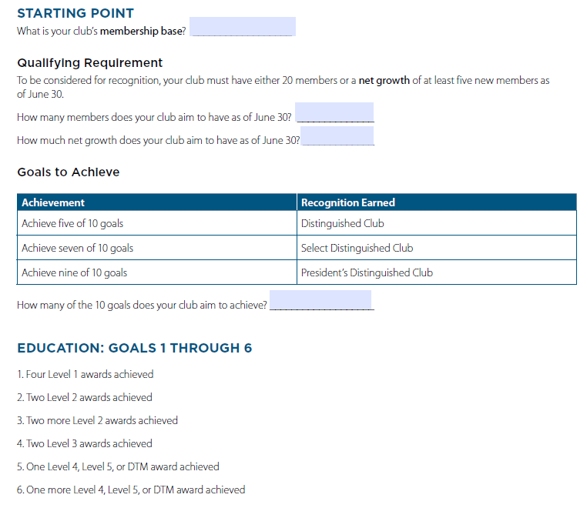
Club Success Plan – Page 4
18 pages
1 - 3) Who we are
➔ 4) Qualifying Requirement
5) State of your club
6 - 8) Education Action Plan
9 -11) Membership Goals
12-14) Training
15-17) Administration
18) Commitment Signatures
Distinguished Club Program & Club Success Plan
toastmasters.org/1111_dcp
21

Slide 16
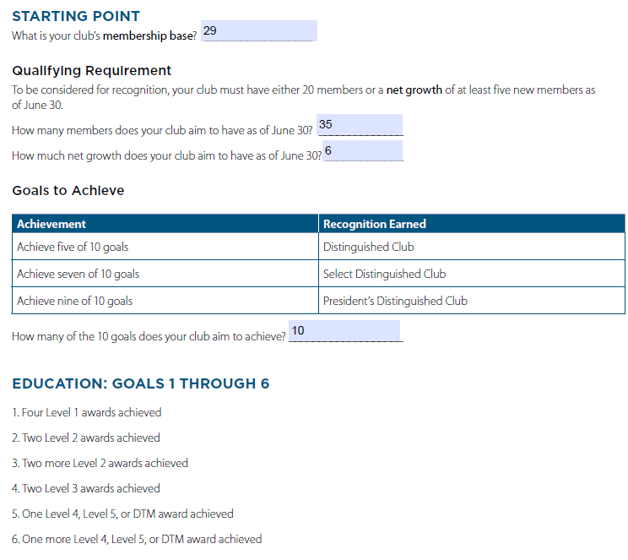
Club Success Plan – Page 4
18 pages
1 - 3) Who we are
➔ 4) Qualifying Requirement
5) State of your club
6 - 8) Education Action Plan
9 -11) Membership Goals
12-14) Training
15-17) Administration
18) Commitment Signatures
Distinguished Club Program & Club Success Plan
toastmasters.org/1111_dcp
21

Slide 17
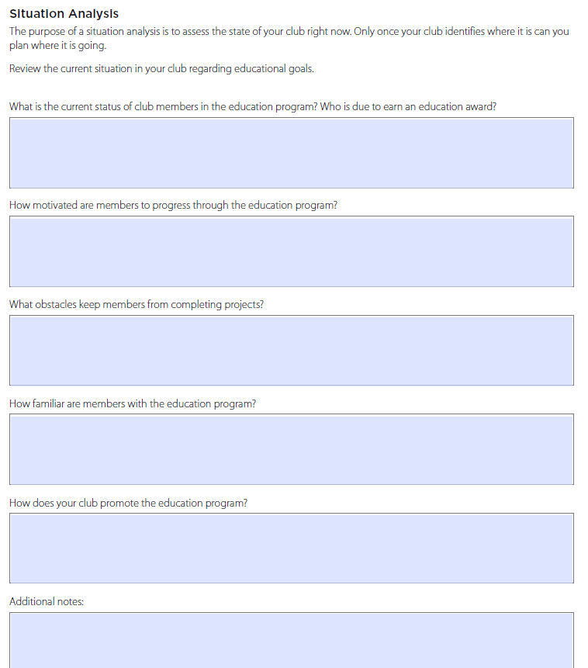
Club Success Plan – Page 5
18 pages
1 - 3) Who we are
4) Qualifying Requirement
➔ 5) State of your club
6 - 8) Education Action Plan
9 -11) Membership Goals
12-14) Training
15-17) Administration
18) Commitment Signatures
Distinguished Club Program & Club Success Plan
toastmasters.org/1111_dcp
21

Slide 18
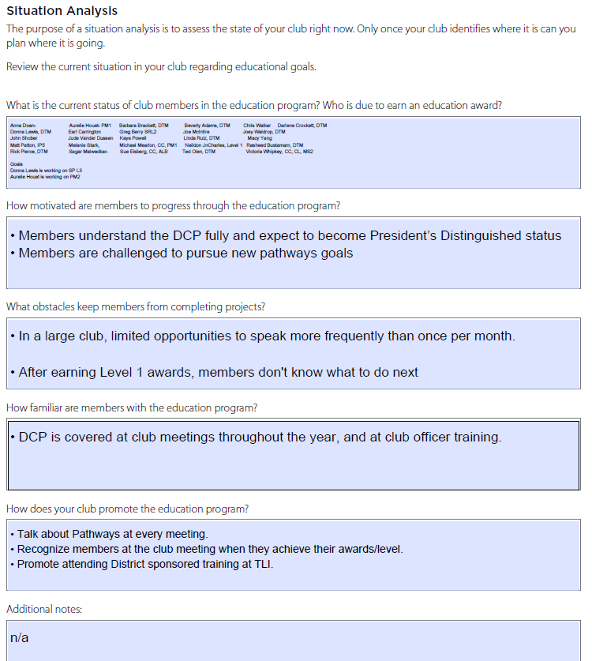
Club Success Plan – Page 5
18 pages
1 - 3) Who we are
4) Qualifying Requirement
➔ 5) State of your club
6 - 8) Education Action Plan
9 -11) Membership Goals
12-14) Training
15-17) Administration
18) Commitment Signatures
Distinguished Club Program & Club Success Plan
toastmasters.org/1111_dcp
21

Slide 19
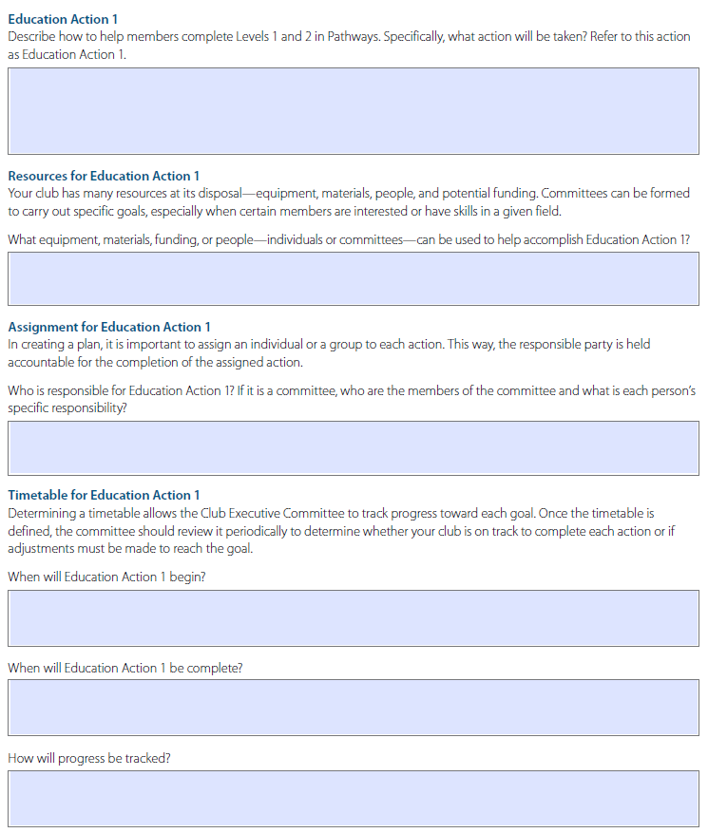
Club Success Plan – Pages 6-8
18 pages
1 - 3) Who we are
4) Qualifying Requirement
5) State of your club
➔ 6 - 8) Education Action Plan
9 -11) Membership Goals
12-14) Training
15-17) Administration
18) Commitment Signatures
Distinguished Club Program & Club Success Plan
toastmasters.org/1111_dcp
21

Slide 20
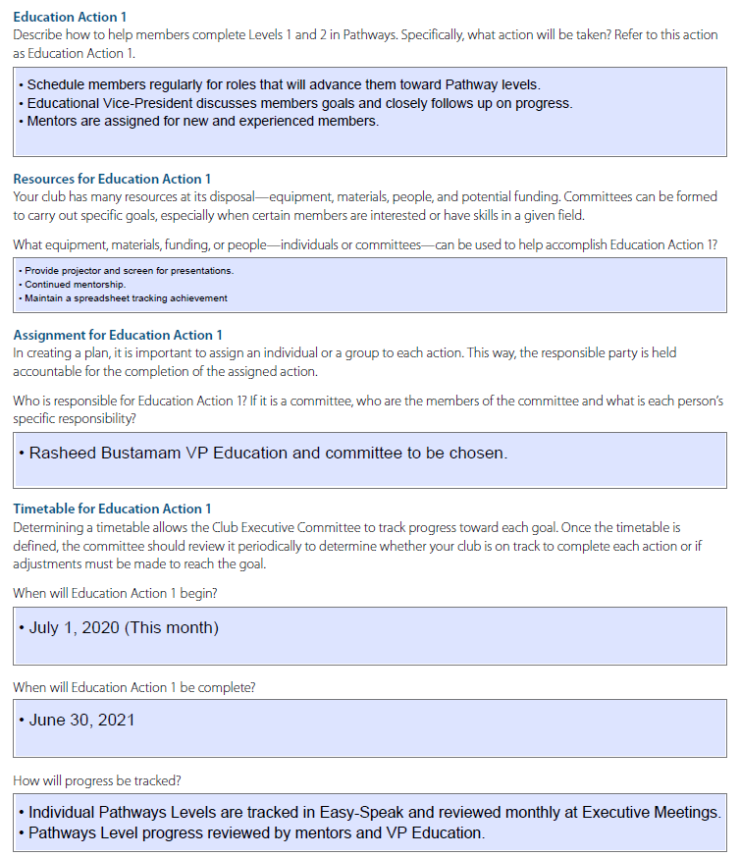
Club Success Plan – Pages 6-8
18 pages
1 - 3) Who we are
4) Qualifying Requirement
5) State of your club
➔ 6 - 8) Education Action Plan
9 -11) Membership Goals
12-14) Training
15-17) Administration
18) Commitment Signatures
Distinguished Club Program & Club Success Plan
toastmasters.org/1111_dcp
21

Slide 21
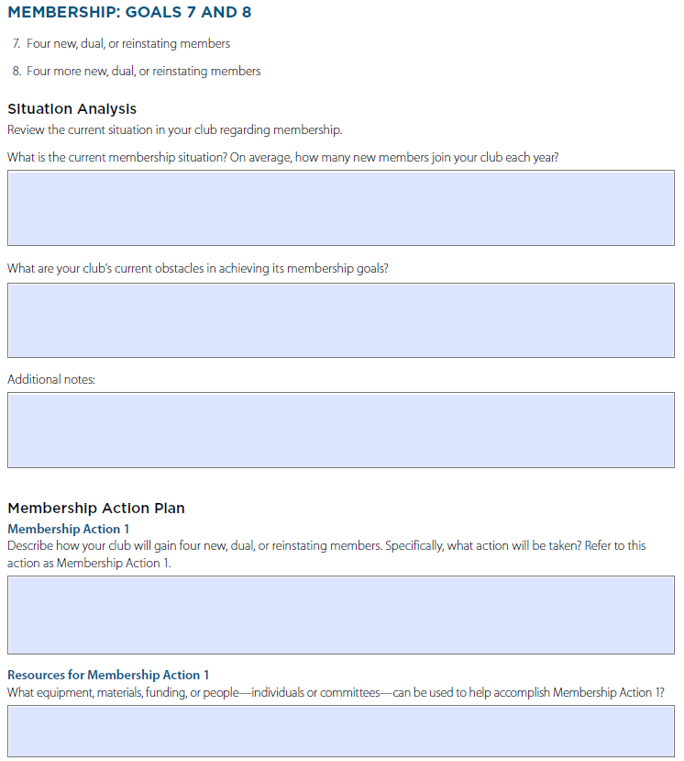
Club Success Plan – Pages 9-11
18 pages
1 - 3) Who we are
4) Qualifying Requirement
5) State of your club
6 - 8) Education Action Plan
➔ 9 -11) Membership Goals
12-14) Training
15-17) Administration
18) Commitment Signatures
Distinguished Club Program & Club Success Plan
toastmasters.org/1111_dcp
21

Slide 22
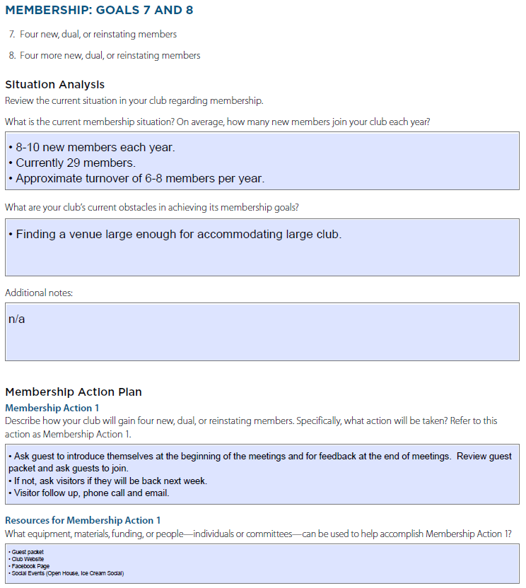
Club Success Plan – Pages 9-11
18 pages
1 - 3) Who we are
4) Qualifying Requirement
5) State of your club
6 - 8) Education Action Plan
➔ 9 -11) Membership Goals
12-14) Training
15-17) Administration
18) Commitment Signatures
Distinguished Club Program & Club Success Plan
toastmasters.org/1111_dcp
21

Slide 23
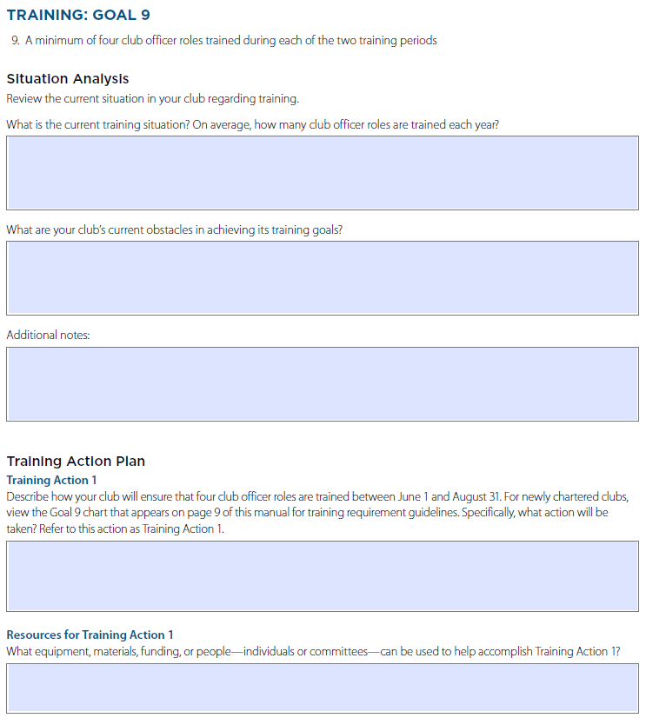
Club Success Plan – Pages 12-14
18 pages
1 - 3) Who we are
4) Qualifying Requirement
5) State of your club
6 - 8) Education Action Plan
9 -11) Membership Goals
➔ 12-14) Training
15-17) Administration
18) Commitment Signatures
Distinguished Club Program & Club Success Plan
toastmasters.org/1111_dcp
21

Slide 24
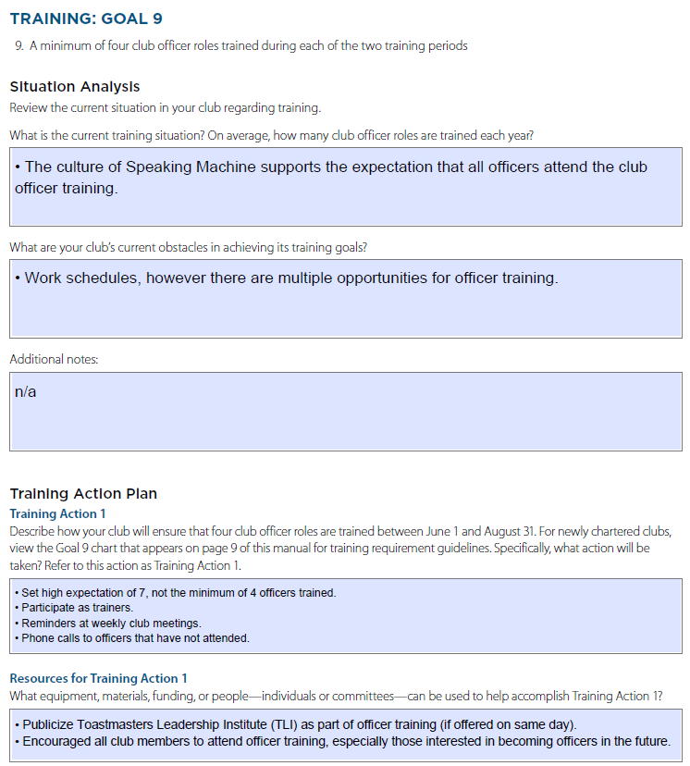
Club Success Plan – Pages 12-14
18 pages
1 - 3) Who we are
4) Qualifying Requirement
5) State of your club
6 - 8) Education Action Plan
9 -11) Membership Goals
➔ 12-14) Training
15-17) Administration
18) Commitment Signatures
Distinguished Club Program & Club Success Plan
toastmasters.org/1111_dcp
21

Slide 25
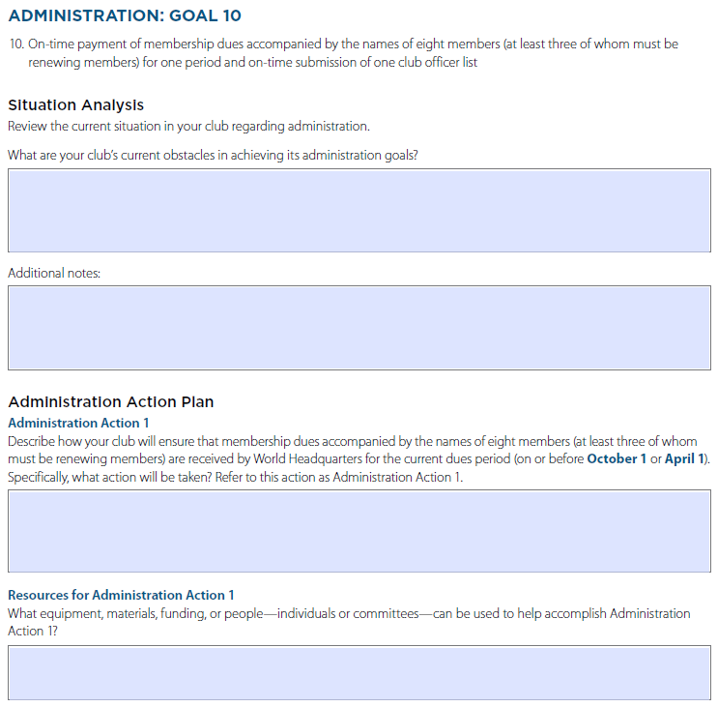
Club Success Plan – Pages 15-17
18 pages
1 - 3) Who we are
4) Qualifying Requirement
5) State of your club
6 - 8) Education Action Plan
9 -11) Membership Goals
12-14) Training
➔ 15-17) Administration
18) Commitment Signatures
Distinguished Club Program & Club Success Plan
toastmasters.org/1111_dcp
21

Slide 26
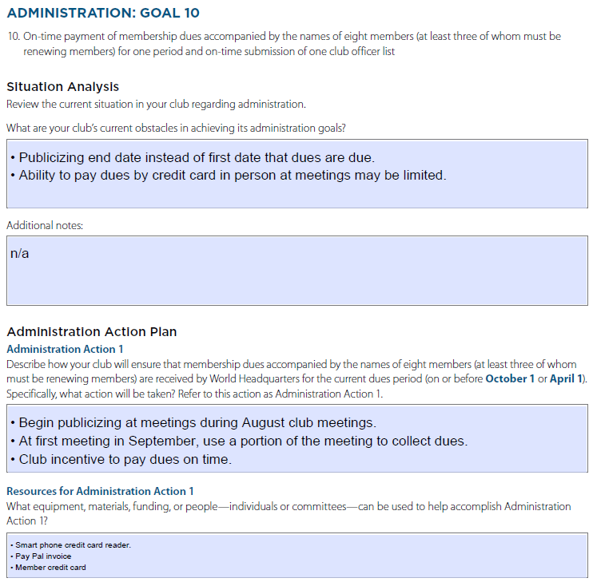
Club Success Plan – Pages 15-17
18 pages
1 - 3) Who we are
4) Qualifying Requirement
5) State of your club
6 - 8) Education Action Plan
9 -11) Membership Goals
12-14) Training
➔ 15-17) Administration
18) Commitment Signatures
Distinguished Club Program & Club Success Plan
toastmasters.org/1111_dcp
21

Slide 27
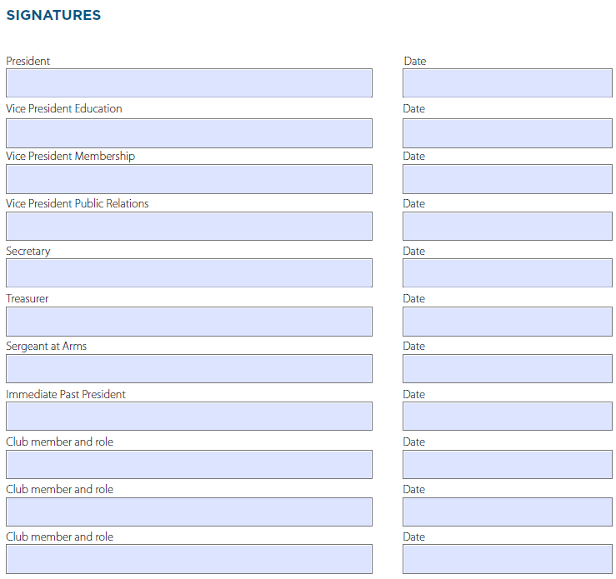
Club Success Plan – Pages 18
18 pages
1 - 3) Who we are
4) Qualifying Requirement
5) State of your club
6 - 8) Education Action Plan
9 -11) Membership Goals
12-14) Training
15-17) Administration
➔ 18) Commitment Signatures
Distinguished Club Program & Club Success Plan
toastmasters.org/1111_dcp
21

Slide 28
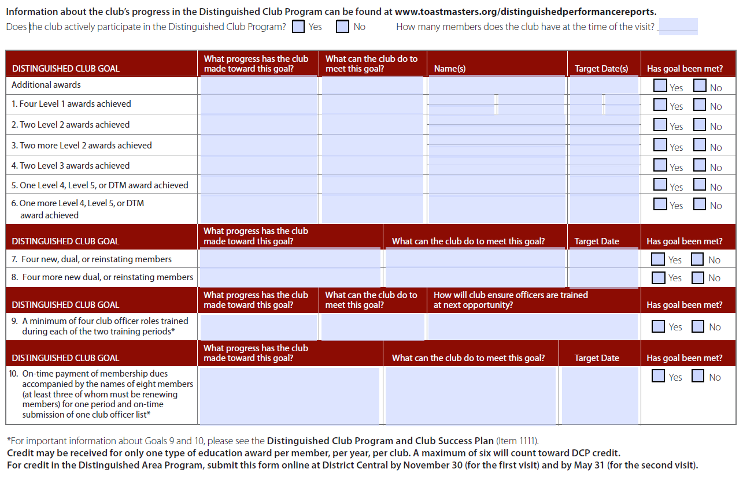
Area Director Club Visit
Area Directors Club Visit Report
toastmasters.org/1471
21

Slide 29
Review
Moments of Truth leads to club quality
Distinguished Club Program is a measure of club health
Club Success Plan with SMART goals will help you achieve success in your Club
Area Director Visit is based on Moments of Truth
24

Slide 30
Conclusion: Closing Remarks
Things we covered in this session
Moments of Truth
Distinguished Club Program
Club Success Plan
All officers need to participate in completing a Club Success Plan
Success planning is a team sport
25

Slide 31
Distinguished Club Program & Club Success Plan
Wes Johnson, DTM,IPDD – wes.johnson@district39.org
Joey Waldrop, DTM, PDG – joey.waldrop@district39.org
Moments of Truth – Toastmasters.org/290
DCP & Club Success Plan Toastmasters.org/1111_dcp
Area Directors Club Visit Report - Toastmasters.org/1471

