Slide 1
Welcome to the District 39 Re-alignment Presentation Town Hall Meeting – April30, 2022
Presented by: Jill Fay
Realignment Chair 2022
Slide 1

Slide 2
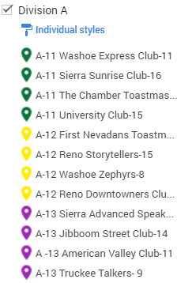
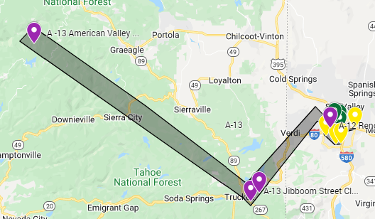
Division A
Division A
Lost 1 Club:
A3 – Blue Tahoe (closed)
Gained 0 clubs
 | Current 2021/2022 | Realignment Changes | Proposed 2022/2023
Areas | 4 | -1 | 3
Clubs | 13 | -1 | 12
Slide 2

Slide 3
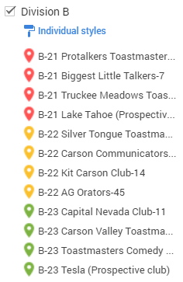
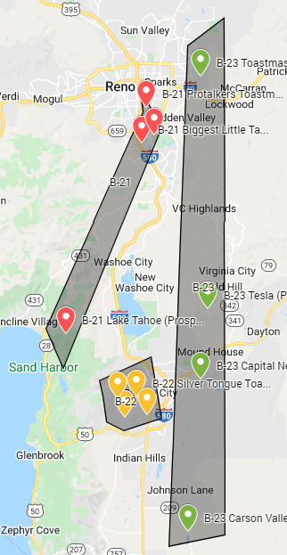
Division B
Division B
Lost 1 Club:
1. B23 – Bently Navada Minden Toastmasters (closed)
Gained 4 Clubs:
1. B21 – Lake Tahoe (Prospective club)
2. B23 – Tesla (Prospective club)
3. B22 – Ag Orators moved from E51
4. B23 - Toastmasters Comedy Club moved from A14.
 | Current 2020/2021 | Realignment Changes | Proposed 2021/2022
Areas | 3 | None | 3
Clubs | 9 | +3 | 12
Slide 3

Slide 4
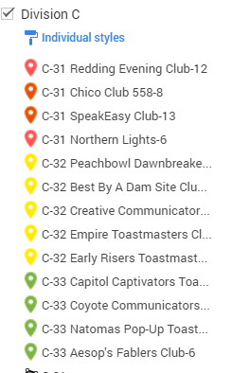
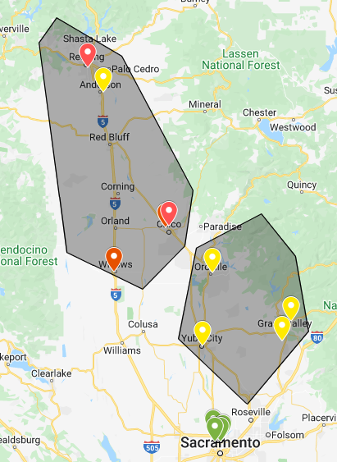
Division C
Division C
Lost 4 clubs:
1. C31 – Paradise Toastmasters On The Ridge Club (closed)
2. C32 – Tehama Speakers (closed)
3. C33 – Funtalkers Toastmasters Club (closed)
4. C33 - Thunder Masters (Moved to F62)
Gained 6 clubs:
C32 – Empire Toastmasters club moved from F63
C32 - Early Risers Toastmasters Club moved from F63
C33 - Capitol Captivators Toastmasters Club moved from J1
C33 - Coyote Communicators Club moved from J1
C33 - Natomas Pop-Up Toastmasters Club moved from J1
C33 - Aesop's Fablers Club moved from J1
 | Current 2020/2021 | Realignment Changes | Proposed 2021/2022
Areas | 3 | None | 3
Clubs | 11 | + 2 | 13
Slide 4
Notes:
4

Slide 5
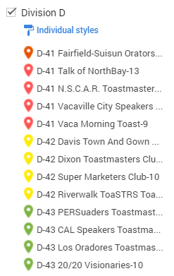
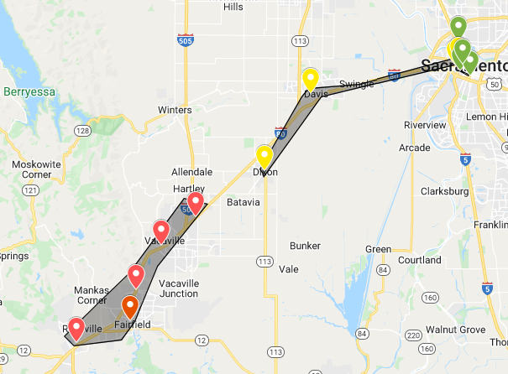
Division D
Division D
Lost 3 club:
1. D41 – CAC Masters (closed).
2. D42 - Davis Daytime Toastmasters (closed).
3. D43 - Delta Breeze (closed).
Gained 6 clubs:
D42 - Super Marketers Club moved from J3
D42 - Riverwalk ToaSTRS moved from J3
D43 - PERSuaders Toastmasters Club moved from J3
D43 - CAL Speakers Toastmasters Club moved from J4
D43 - Los Oradores Toastmasters Club moved from J2
D43 - 20/20 Visionaries moved from J2.
 | Current 2020/2021 | Realignment Changes | Proposed 2021/2022
Areas | 3 | None | 3
Clubs | 10 | +3 | 13
Slide 5

Slide 6
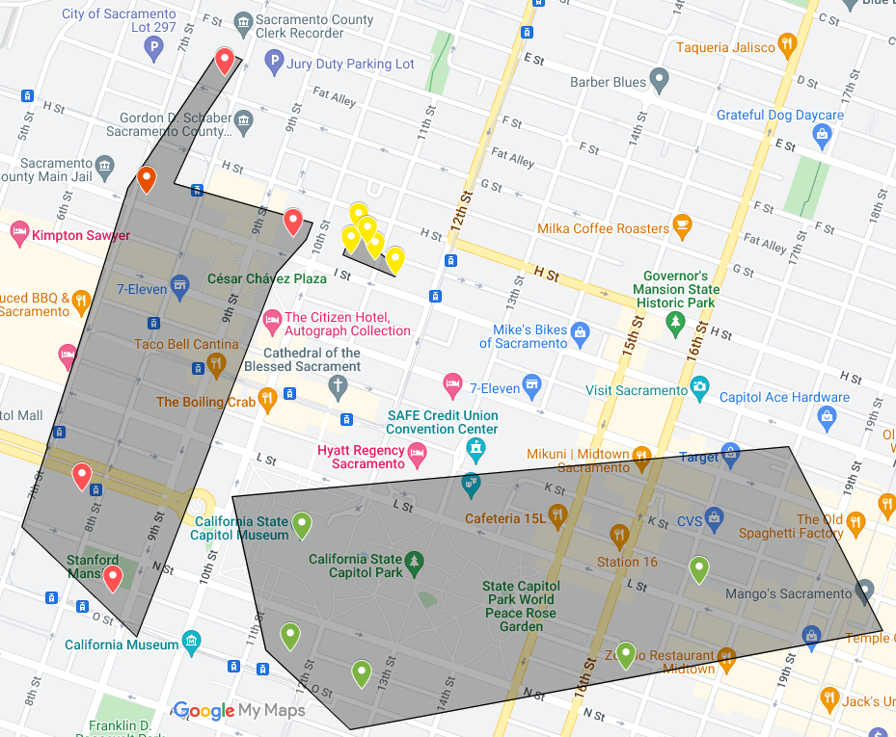
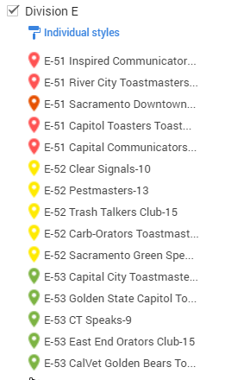
Division E
Division E
Lost 3 clubs
1. E51 - Master Talkers Toastmasters Club (closed)
2. E52 – Strictly Speaking Toastmasters (closed)
3. E51 - Ag Orators Toastmasters Club moved to B22
Gained 0 clubs
Moved 9 Clubs:
1. E52 - Capital Communicators Club moved to E51
2. E52 - Capitol Toasters Toastmasters Club moved to E51
3. E53 - Clear Signals moved to E52
4. E53 - Pestmasters Toastmasters Club moved to E52
5. E53 - Trash Talkers Club moved to E52
6. E53 - Sacramento Green Speakers moved to E52.
7. E54 - Captital City Toastmasters Club moved to E53
8. E54 - Golden State Capitol Toastmasters moved to E53.
9. E54 - East End Orators Club moved to E53.
 | Current 2020/2021 | Realignment Changes | Proposed2021/2022
Areas | 4 | -1 | 3
Clubs | 18 | -3 | 15
Slide 6
Notes:
6

Slide 7
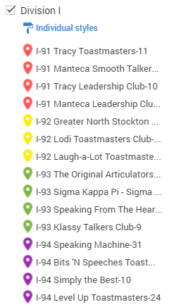
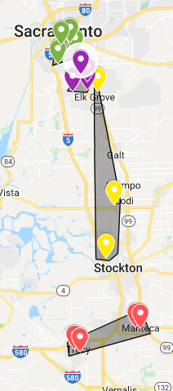
Division F
Division F:
Lost 3 clubs:
1. F61 - Empire (Moved to C32)
2. F63 - Early Risers (Moved to C32)
3. F62 – Gold County (closed)
Gained 1 clubs:
1. F62 - Thunder Masters (moved from C32)
Moved Clubs
1. F63 - Voices of Lincoln Toastmasters Club moved to F61.
2. F62 - Roseville Rappers Club moved to F61.
3. F61 - Foothill Toastmasters Club moved to 63
4. F61 - Roseville Toasters Club moved to 63
5. F64 - Placer's Gold Club moved to 63.
 | Current 2020/2021 | Realignment Changes | Proposed 2021/2022
Areas | 4 | -1 | 3
Clubs | 14 | -2 | 12
Slide 7
Notes:
7

Slide 8
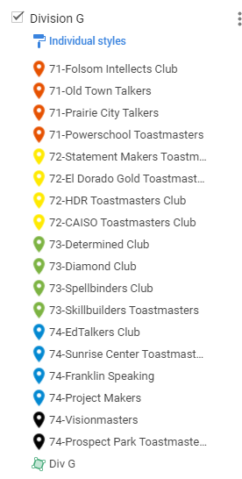
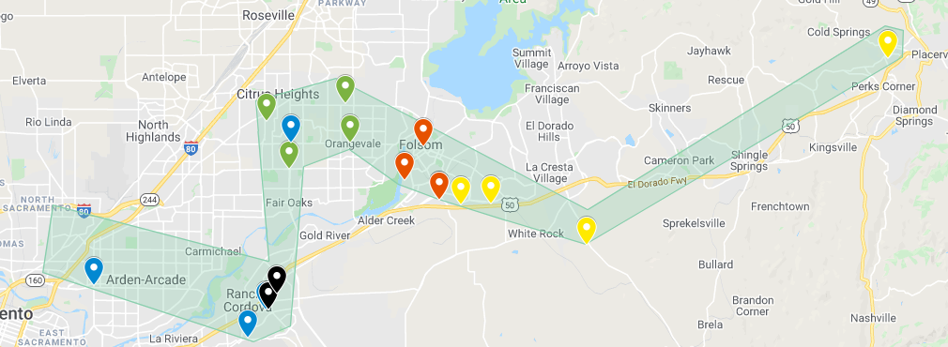
Division G
Division G:
Lost 5 Clubs:
1. G71 - Powerschool Toastmasters (closed).
2. G73 - The Cinnamon Toastmasters (closed).
3. G74 – Visionmasters (closed).
4. G74 - Prospect Park Toastmasters (closed).
5. G74 - Franklin Speaking (closed).
Gained 0 Club:
Moved 1 Club:
1. G74 – EdTalkers Club moved to G71.
2. G74 – Project Makers moved to G71.
3. G71 - HDR Toastmasters Club moved to G72.
 | Current 2020/2021 | Realignment Changes | Proposed 2021/2022
Areas | 4 | -1 | 3
Clubs | 19 | -5 | 14
Slide 8
Notes:
8

Slide 9
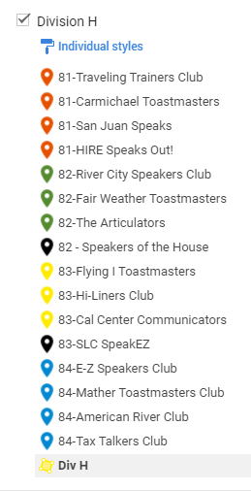
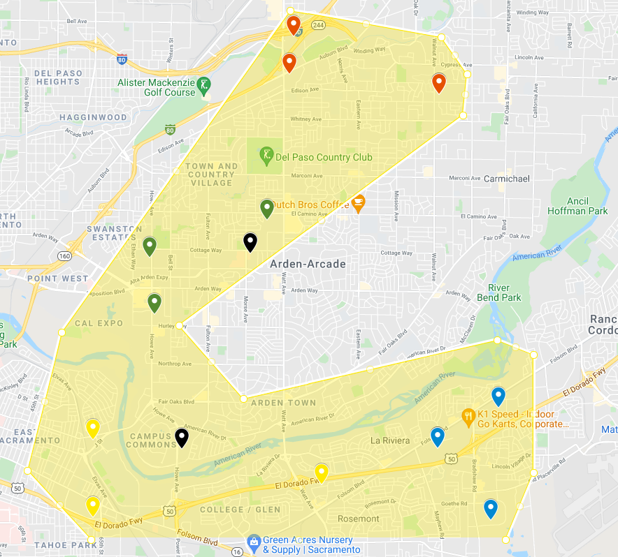
Division H
Division H:
Lost 2 Clubs:
1. H82 – Speakers of the House (closed )
2. H83 - SLC SpeakEZ (closed)
Gained 4 Clubs:
H84 - Farmers Market Club from J5
H84 - Sutter Toastmasters Club from J5
H84 - Power Talkers from J5
H84 - Reveilliers Club from J4.
Moved Clubs:
1. H81 - Mather Toastmasters Club moved from J84
2. H81 - American River Club moved from J84
3. H82 - HIRE Speaks Out! moved from J81
4. H82 - Flying I Toastmasters moved from J83
5. H83 - E-Z Speakers Club moved from J84
6. H83 - Tax Talkers Club moved from J84.
 | Current 2020/2021 | Realignment Changes | Proposed 2021/2022
Areas | 4 | none | 4
Clubs | 17 | +2 | 19
Slide 9
Notes:
9

Slide 10
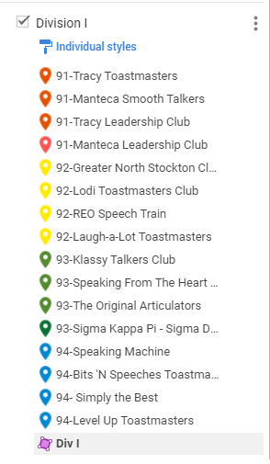
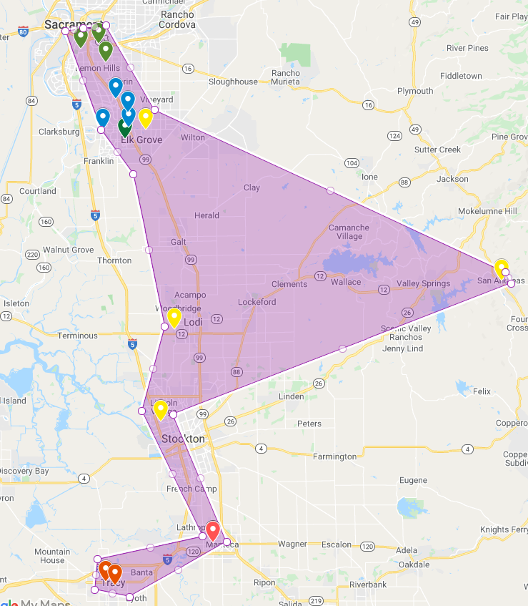
Division I
Division I:
Lost 0 Clubs:
Gained 0 Clubs:
Moved 0 Clubs:
 | Current 2020/2021 | Realignment Changes | Proposed 2021/2022
Areas | 4 | None | 4
Clubs | 16 | None | 16
Slide 10
Notes:
10

Slide 11
Division J
 | Current 2020/2021 | Realignment Changes | Proposed 2021/2022
Areas | 5 | -5 | 0
Clubs | 20 | --20 | 0
Slide 11
Notes:
11

Slide 12
Q & A
Slide 12
Notes:
12

