Slide 1
MEMBERSHIP GROWTH
Preparation and Marketing
Notes:
Membership Growth Rev. 1/2018 Item 1159 Page 4
In 1924, Dr. Ralph C. Smedley began his mission of helping others become more effective communicators and leaders. That mission remains alive today, as members continue to benefit from the Toastmasters program in friendly and supportive clubs throughout the world.
A Toastmasters club is most beneficial to its members when operating at charter strength, which means 20 or more active members. This ensures ample opportunity to speak and lead within a more diverse group. To offset membership attrition, each club needs a constant influx of new members and should regularly devote time and effort towards promoting membership growth.
With more members, clubs gain:
Increased enthusiasm at club meetings and functions
Membership diversity, which enriches all aspects of club programs
Greater depth of leadership and collaboration
Additional funding for club supplies and events
In turn, members will benefit from a stronger communication and leadership development program that’s better suited to furthering professional and personal goals as well as improving local communities and organizations. The need for better communication and leadership is everywhere, and Toastmasters clubs must be ready to meet that need.
Let us share the benefits we have gained for ourselves with others.
– Dr. Ralph C. Smedley

Slide 2
MEMBERSHIP GROWTH
Preparation
Notes:
Membership Growth Rev. 1/2018 Item 1159 Page 8

Slide 3
PREPARATION – Moments of Truth
MOMENTS OF TRUTH
Effective meetings
Continually promoting Toastmasters
Proven marketing techniques
Competing and staying involved
Incentivizing and recognizing members
Notes:
Preparation Rev. 1/2018 Item 1159 Page 5
Moments of Truth -To prepare your club for growth, it is imperative to first identify any opportunities for improvement in the overall club experience. Club growth depends on several factors, such as:
1. Having effective club meetings that are worthwhile for new and veteran members alike.
2. Continually promoting Toastmasters throughout your community and/or organization.
3. Using proven marketing techniques to turn prospects into guests and guests into members.
4. Competing and staying involved within the club, area, division and district.
5. Incentivizing and recognizing members who contribute to the strength of your club.
Clubs that maintain a high standard of excellence in their club programming, operations, management, member participation and community activities are more likely to attract and retain new members. If your guests typically don’t join and new members tend not to stay for very long, the club is probably not meeting their needs. To experience sustained growth, a club needs to be worth belonging to.
To ensure your club is prepared for growth, review and utilize the Moments of Truth (Item 290) module we discussed earlier.

Slide 4
PREPARATION – Committees
MEMBERSHIP
COMMITTEE
PUBLIC RELATIONS COMMITTEE
Notes:
Preparation Rev. 1/2018 Item 1159 Page 7
Sustaining club growth is no easy task and can quickly become overwhelming if assigned to only few individuals. A collaborative and coordinated effort is necessary to prepare your club for growth. If not already in place, form a club membership committee and public relations committee to share in the responsibilities of promoting your club and building its membership.
CLUB CONSTITUTION FOR CLUBS OF TOASTMASTERS INTERNATIONAL
Article VIII: Committees, Section 4: Membership
The membership committee … shall arrange for proper induction of all new individual members. This
committee shall be responsible for maintaining club individual membership and attendance. It shall
be the goal of this committee to ensure that the individual membership of this club is at all times at
charter strength or better.
Article VIII: Committees, Section 5: Public Relations
The public relations committee shall arrange the preparation and dissemination of news releases regarding this club’s activities and educational programs and shall also promote opportunities for community participation in Toastmasters International’s learning programs. It shall also be responsible
for all internal publications of this club, including the club website, social media, and newsletter.

Slide 5
PREPARATION – Committees
MEMBERSHIP COMMITTEE
Application consideration
Induction of new members
Individual membership and attendance
Goal: Keep club membership at charter strength or better
Notes:
Preparation Rev. 1/2018 Item 1159 Page 7
The membership committee considers all applications for individual membership and reports
back to the club, arranges for proper induction of all new individual members, is responsible for maintaining club individual membership and attendance. It is the goal of the membership committee to ensure that the individual membership of the club is at all times at
charter strength or better.

Slide 6
PREPARATION – Committees
PUBLIC RELATIONS COMMITTEE
News releases
Community participation in Toastmaster learning programs
Internal publications – website, social media, and newsletter
Notes:
Preparation Rev. 1/2018 Item 1159 Page 7
The public relations committee arranges the preparation and dissemination of news releases regarding the club’s activities and educational programs and promotes opportunities for community participation in Toastmasters learning programs. It is also responsible for all internal publications including the club website, social media, and newsletter.

Slide 7
PREPARATION – Committees
MEMBERSHIP AND PUBLIC RELATIONS COMMITTEES
Chaired by respective VP’s
Committee members
- Work well together
- Committed to serving the club
Notes:
Preparation Rev. 1/2018 Item 1159 Page 7
The membership and public relations committees are typically chaired by the vice president membership and vice president public relations, respectively. These committees should each be comprised of three club members or more who work well together and are committed to serving the interests of the club.
When asking for volunteers, emphasize the benefits of serving on a committee, including the experience gained in interpersonal communication, group discussions and team collaboration. Stress how important committee contributions are to the success of your club.

Slide 8
PREPARATION – Committees
FIRST COMMITTEE MEETING
Review objectives and responsibilities
Set reasonable milestones and target dates
Delegate fairly
Fully, clearly describe tasks and expectations
Make resources known
Provide support
Notes:
Preparation Rev. 1/2018 Item 1159 Page 7
Dedicate the first committee meeting to reviewing objectives and responsibilities. Set reasonable milestones and target dates, and delegate tasks fairly among the group. Be sure to fully and clearly describe all tasks and expected results, and make known all available resources that can help achieve your objectives. If any committee member needs assistance performing their duties, be sure to provide the additional support they require.

Slide 9
PREPARATION – Committees
FIRST COMMITTEE MEETING
Leverage members’ expertise
Foster communication and participation
Increase productivity by utilizing parliamentary procedure basics
Notes:
Preparation Rev. 1/2018 Item 1159 Page 7
Whenever possible, it is best to assign duties in a way that leverages your members’ expertise. Ask members for assistance in areas that align with their interests and skillsets; this shows an appreciation of their talents and helps ensure all tasks will be capably completed.
Foster communication and participation as much as possible during this process, encouraging input from each member on the decisions made and allowing discussion and debate regarding the different ideas presented. Be sure each member feels respected and valued, despite any disagreements—acknowledging members for their suggestions and contributions will inspire a higher level of commitment.
You can increase the productivity of committee meetings by putting into practice the basics of parliamentary procedure. Although members cannot be expected to be experts on this subject, encourage them to become familiar with the basic principles. Chairman (Item 200) and Henderson’s Parliamentary Guide (Item 170) are available for purchase on the Toastmasters Online Store, and can serve as introductory guides to parliamentary procedure within the club setting.

Slide 10
MEMBERSHIP GROWTH
Marketing
Notes:
Membership Growth Rev. 1/2018 Item 1159 Page 8
MARKETING
Outlining a Toastmaster’s journey can provide an important framework for developing your marketing strategy. Every Toastmaster was at one time a prospect, unaware of the Toastmasters program.
Once they were introduced to the concept of membership and convinced of its benefits, they chose to be a guest and experience a club meeting firsthand to confirm whether the program was truly right for them.
Once they witnessed for themselves the value of the club environment, they decided to become a member, and they remained a member because they felt the program continued to contribute to their self-development.

Slide 11
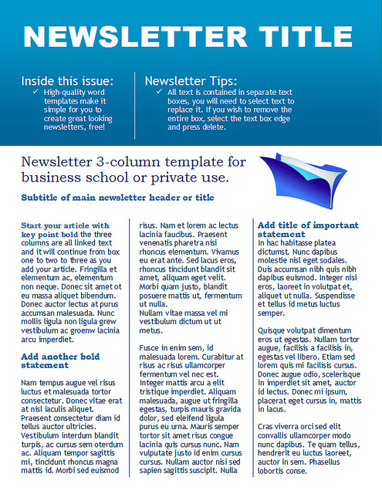
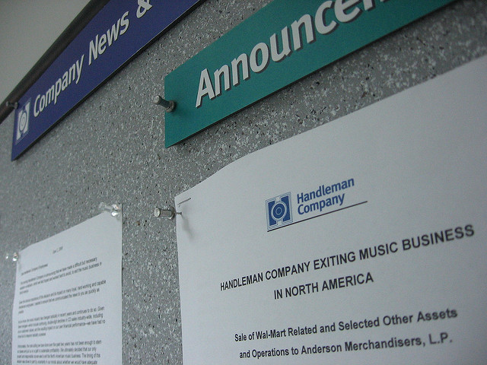
FROM PROSPECT TO GUEST – Create Awareness
CREATE AWARENESS
Ongoing promotion
This Photo by Unknown Author is licensed under CC BY
This Photo by Unknown Author is licensed under CC BY-SA
Notes:
Membership Growth Rev. 1/2018 Item 1159 Page 8
Ongoing promotion is vital to your club growth. Promotion can take many forms, including advertising, public relations and membership campaigns within your club. Your promotional efforts will hinge on the funds available and the nature of your market. For instance, a corporate club might benefit more from exposure in the company magazine or bulletin board than in a newspaper. Segment your market for effective promotion.

Slide 12
FROM PROSPECT TO GUEST – Create Awareness
ONLINE TOOLS
Find a club
Notes:
Membership Growth Rev. 1/2018 Item 1159 Page 8
Find a Club – Ensure your club contact and meeting information are always current on the Find a Club tool on the Toastmasters website.
Updates can be made in Club Central by selecting Club Contact and Meeting Information.

Slide 13
FROM PROSPECT TO GUEST – Create Awareness
ONLINE TOOLS
Find a club
Club website
Notes:
Membership Growth Rev. 1/2018 Item 1159 Page 8
Club Website – Creating a website is a great way to display the unique personality of your club.
Be sure to include any information a potential guest should know before visiting, such as special parking instructions or if there is a dress code.
You can also list answers to frequently asked questions about your club or Toastmasters International. Above all, use your club website as an opportunity to showcase why someone should consider joining your club.

Slide 14
FROM PROSPECT TO GUEST – Create Awareness
ONLINE TOOLS
Find a club
Club website
Social media
Notes:
Membership Growth Rev. 1/2018 Item 1159 Page 8
Social Media – Use all social media channels available to you—e.g., Facebook, Twitter, YouTube—to share information and ideas with other members and generate excitement about your club.
Encourage members to actively promote your club on social media and share their positive experiences with their friends, family and others.

Slide 15
FROM PROSPECT TO GUEST – Create Awareness
ONLINE TOOLS
Find a club
Club website
Social media
Social networks
Notes:
Membership Growth Rev. 1/2018 Item 1159 Page 8
Social Networks – Take advantage of social networking to reach out to those with similar interests and goals.
You can use Meetup to organize and promote events for those in your area interested in public speaking or self-development.
Use LinkedIn to connect with those who are academically or professionally driven—including other members from around the world—and discuss common problems, solutions and successful strategies

Slide 16
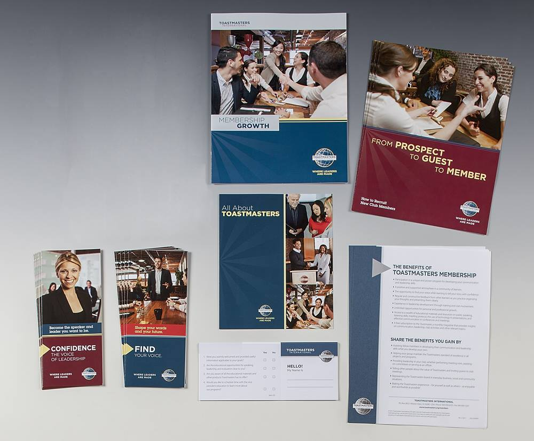
FROM PROSPECT TO GUEST – Create Awareness
OFFLINE PRESENCE
Displays
Notes:
Membership Growth Rev. 1/2018 Item 1159 Page 8 & 9
It is also important to cultivate an offline presence throughout your community. Here are some effective ways to raise awareness about your club:
Displays – Within each community, there are special celebrations, conferences and conventions conducted throughout the year. Many communities would be willing to provide your club a space at one of these events. Some clubs arrange for window displays in banks, stores, airports and libraries during club anniversary week.
Exhibits like these are an excellent way to introduce Toastmasters programs to a large number of people in a short period of time. When preparing a display, utilize materials which tell your story effectively.
Depending on the space available, consider including the following:
■ Club banner ■ Educational materials
■ Agenda for the next meeting ■ Poster with contact names and phone numbers
■ Fliers and marketing materials

Slide 17
FROM PROSPECT TO GUEST – Create Awareness
OFFLINE PRESENCE
Displays
Brochures
Notes:
Membership Growth Rev. 1/2018 Item 1159 Page 9
When organizing a booth, you should arrange for club members to be present to answer questions. Each Toastmaster in the booth should be given an orientation on what to say to prospects they meet.
Have each prospect complete a registration card. The information gathered on these cards can be used for follow-up contact and as part of a drawing for an inexpensive award to help attract visitors to the exhibit.
Brochures – A number of eye-catching and informational brochures are available from World Headquarters for nominal costs at www.toastmasters.org/Shop.
Always keep an adequate supply on hand to present to prospective members, both at your club meetings and wherever you meet people.
All brochures provide the address of World Headquarters as a contact, but for the most effective results, have your club contact information printed on labels to use in the space provided on the brochures.
You can also use the resources at www.toastmasters.org/Logos to customize and print your own brochures.

Slide 18
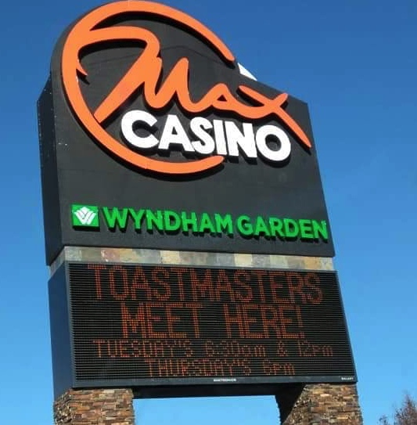
FROM PROSPECT TO GUEST – Create Awareness
OFFLINE PRESENCE
Displays
Brochures
Signage
Notes:
Membership Growth Rev. 1/2018 Item 1159 Page 9
Signage – Do not forget to mark your meeting place on the Club Meeting Plaque (Item 384) or Customizable Meeting Sign (Item 6996). Both are excellent means of encouraging drop-in guests at your meetings. If allowed, the Customizable Meeting Sign can also be posted outside your meeting venue to direct passersby to your club’s website or social media pages.
In addition to these ideas, refer to Let the World Know: Publicity and Promotion for more comprehensive coverage on effective promotion and publicity.
Above all else, personal contact and references are the most effective kind of promotion. Encourage your members to promote your Toastmasters club among their friends and contacts. Widespread advertising and publicity were never meant to replace personal invitations, but rather to increase public awareness and
acceptance of Toastmasters and make the first contact with a prospect easier and more successful.
However, making prospects aware of your club is not enough. In Toastmasters, marketing efforts must be member-focused, tailored to address prospects’ needs. Promoting membership should be a human experience. Once you find those who would be interested in joining your club and reaping the benefits Toastmasters offers, next you must grab their attention.

Slide 19
FROM PROSPECT TO GUEST – Cultivate Interest
OFFLINE PRESENCE
“Sales” materials:
- Features—not benefits
Notes:
Membership Growth Rev. 1/2018 Item 1159 Page 9
Cultivate Interest
People typically don’t buy or invest in something without first being convinced of its value. Start with a good sales letter. Remember to write as you would talk, and write from the prospect’s point of view. In the letter, refer the person to www.toastmasters.org to learn more about Toastmasters and how it has helped others.
Most sales materials talk about features, not benefits. They describe size, gadgets and gimmicks, not what their features do for the customer. People want to know what Toastmasters will do for them, not what they can do for Toastmasters, so show what Toastmasters has done for you and other members.

Slide 20
FROM PROSPECT TO GUEST – Cultivate Interest
OFFLINE PRESENCE
“Sales” materials:
- Features—not benefits
Focus on what Toastmasters can do
for THEM
- Features, Benefits, and Value Chart
Notes:
Membership Growth Rev. 1/2018 Item 1159 Page 9 & 10
Use the Features, Benefits and Value chart (www.toastmasters.org/FBVChart) to illustrate the benefits Toastmasters offers and the value to them.

Slide 21
FROM PROSPECT TO GUEST – Cost Objections
COUNTERING OBJECTIONS
TO PROGRAM COST
Help recognize value
- Features, Benefits, and Value Chart
Notes:
Membership Growth Rev. 1/2018 Item 1159 Page 10
What do you do if you run into objections over the cost of the program?
The problem is typically not the cost but that the prospect does not recognize the value. The Features, Benefits and Value chart will help overcome this obstacle.

Slide 22
FROM PROSPECT TO GUEST – Cost Objections
COUNTERING OBJECTIONS
TO PROGRAM COST
Help recognize value
- Features, Benefits, and Value Chart
Draw comparisons
Notes:
Membership Growth Rev. 1/2018 Item 1159 Page 9 & 10
Draw comparisons. Point out that most one-day seminars cost more than a year’s worth of member dues in Toastmasters.
Ask how much the prospect would pay to belong to a networking group, and point out that most of those groups provide no educational literature.

Slide 23
FROM PROSPECT TO GUEST – Cost Objections
COUNTERING OBJECTIONS
TO PROGRAM COST
Help recognize value
- Features, Benefits, and Value Chart
Draw comparisons
Help them visualize their own success
Notes:
Membership Growth Rev. 1/2018 Item 1159 Page 9 & 10
Paint a verbal picture of the prospect standing before a large group of people, speaking eloquently, leading an effective meeting with confidence or speaking extemporaneously in a clear and concise manner. This will help them visualize themselves enjoying the benefits of belonging to a club.
One effective method of proving your case is to use testimonial letters in your membership campaigns and club-building activities.
Also, inform prospects of the value the meeting itself offers as a testimonial; assure them the experience will speak for itself, and share how your current members—once in their same position—were sold on the value after experiencing a club meeting for themselves.
Lean on your club members for inspiration. Ask what primary factors swayed them to visit for the first time, and strive to recreate similar positive experiences for each new prospect.

Slide 24
FROM GUEST TO MEMBER– First Meeting
FIRST MEETING
Before the meeting
Notes:
Membership Growth Rev. 1/2018 Item 1159 Page 10
Before the Meeting
• Greet guests as they arrive at the door, and warmly introduce them to officers and members.
• Invite guests to sign the Guest Book (Item 84), and provide them all supplies that will be needed throughout the meeting (e.g., agenda, ballots, evaluation forms and pen or pencil).
• Ask guests if they would like to participate in the meeting, such as in Table Topics®.
• Pair guests with an officer or veteran member who can sit next to them and explain the program and club operations as the meeting progresses.

Slide 25
FROM GUEST TO MEMBER– First Meeting
FIRST MEETING
Before the meeting
During the meeting
Notes:
Membership Growth Rev. 1/2018 Item 1159 Page 10
During the Meeting
• Thank your guests for attending, and recognize each one by name.
• Be sure to explain each part of the meeting so guests can fully participate.
• Before adjourning, ask your guests if they would like to share any thoughts on their experience.

Slide 26
FROM GUEST TO MEMBER– First Meeting
FIRST MEETING
Before the meeting
During the meeting
After the meeting
Notes:
Membership Growth Rev. 1/2018 Item 1159 Page 10
After the Meeting
• Provide each guest with a Guest Packet.
• Ask your guests if they have any questions or concerns you can help with.
• Reinforce the benefits of Toastmasters—share your members’ success stories.
• Provide guests a membership application, and invite them to join.

Slide 27
FROM GUEST TO MEMBER– New Member
NEW MEMBER
Induction
Notes:
Membership Growth Rev. 1/2018 Item 1159 Page 11
Induction
When your club admits new members, make an event of the occasion by holding a formal induction ceremony—Induction Ceremony for New Members (Item 1167K) can be used as a reference script for the inducting officer.
Provide new members the Member Welcome Kit (Item 1167) as part of their induction as well as the Membership Pin (Item 5757) and Membership Certificate (Item 513) or other mementos.

Slide 28
FROM GUEST TO MEMBER– New Member
NEW MEMBER
Induction
Orientation
Notes:
Membership Growth Rev. 1/2018 Item 1159 Page 11
Orientation
Shortly after an induction ceremony, conduct an orientation to help familiarize new members with the structure of your club and the Pathways learning experience.
Refer new members to Orienting New Members (Item 1167J) for more information.

Slide 29
FROM GUEST TO MEMBER– New Member
NEW MEMBER
Induction
Orientation
Notes:
Membership Growth Rev. 1/2018 Item 1159 Page 11
Orientation
Shortly after an induction ceremony, conduct an orientation to help familiarize new members with the structure of your club and the Pathways learning experience.
Refer new members to Orienting New Members (Item 1167J) for more information.

Slide 30
CONTINUED SUCCESS
Promotional Programs
& Tools
Notes:
Membership Growth Rev. 1/2018 Item 1159 Page 11
Promotional Programs & Tools

Slide 31
CONTINUED SUCCESS – Promotional Programs
& Tools
SPEECHCRAFT
Notes:
Membership Growth Rev. 1/2018 Item 1159 Page 11
Now that your club’s strengths and weaknesses have been analyzed, your marketing plan has been devised and your members are ready to grow your club, it’s important to not let your momentum falter. Remember that membership growth is not a one-time project or event. Your club should be committed to continually promoting and building membership. The following are some helpful promotional programs and tools available to you:
Speechcraft
Speechcraft is a great opportunity for you to introduce non-members to the fundamentals of public speaking. It can be offered as an integral part of your club meeting or as a seminar-style program presented outside of your club. When you organize a Speechcraft workshop, you are planning for new members.
These workshops can serve as the introductory or trial offer for people who are reluctant to commit to membership. Clubs that are somewhat low in membership may want to partner with another club to put on a joint Speechcraft workshop. The Speechcraft Starter Kit (Item 205) contains all the necessary materials for starting and publicizing a Speechcraft workshop.
How do you turn participants of these workshops into members? Make them feel welcome at your meetings. Most importantly, before completing the final session, talk with participants and invite them to become members of your club. More information on Speechcraft and other community-based programs can be found here.

Slide 32
CONTINUED SUCCESS – Promotional Programs
& Tools
MEMBERSHIP-BUILDING PROGRAMS
- Kickoff
Notes:
Membership Growth Rev. 1/2018 Item 1159 Page 11
Membership-Building Programs
Special incentives are offered to members and clubs every year through membership building programs. Club competitions can be combined with annual membership building programs or can be created with your own themes. These are a great incentive for motivating your members to participate in membership building and are a great way to attract new members and boost club attendance. Each competition’s rules should be developed by a committee of team captains. Every member should
be assigned to a team, and the number of teams should be at least three. A general contest chair should be selected whose duties will be to ensure that rules are adhered to and that teams are on the move. Under the general contest chair, team captains develop their team program to win the contest.
Kickoff – Plan to have a special kickoff event to begin the contest. Your kickoff meeting should be planned to motivate the teams to get out and get things done! A great start to your membership building contest will furnish a certain amount of momentum, but to maintain this momentum you must look to your programming. It is one thing to attract a number of guests to a meeting, it is quite another to inspire them to return and eventually join.

Slide 33
CONTINUED SUCCESS – Promotional Programs
& Tools
MEMBERSHIP-BUILDING PROGRAMS
- Kickoff
- Keep score
Notes:
Membership Growth Rev. 1/2018 Item 1159 Page 11
Keep Score – It’s important to establish rules to fit each club’s situation, develop team assignments and set realistic goals for the contest. It is also important to have a system of reporting membership gains on a continual basis. One effective ways to do this is with a graphic comparison. These charts or graphs should be a prominent feature of every meeting. Be sure to report the names of new members and each team’s progress in your club newsletter.

Slide 34
CONTINUED SUCCESS – Promotional Programs
& Tools
MEMBERSHIP-BUILDING PROGRAMS
- Kickoff
- Keep score
- Prospect list
Notes:
Membership Growth Rev. 1/2018 Item 1159 Page 12
Prospect List – Each team should develop a prospect list by determining who among members’ friends, acquaintances and associates could benefit from Toastmasters.
You can also find local prospects by searching in social media apps (Facebook, Instagram or Meetup), and remember to use relevant keywords or hashtags, including #publicspeaking, #leadership, etc., to find users looking for speaking and leadership development opportunities.

Slide 35
CONTINUED SUCCESS – Promotional Programs
& Tools
BUSINESS AWARENESS PROGRAM
- Develop a list
Notes:
Membership Growth Rev. 1/2018 Item 1159 Page 12
Business Awareness Program
The value of Toastmasters as an employee training tool is championed by thousands of companies and government agencies around the world. While Toastmasters corporate clubs are a wonderful way for companies to benefit their employees, some organizations can better serve their employees by encouraging them to join a local club, like yours. A business awareness program helps community clubs increase membership through contacts with businesses in their area, and it can also be adapted for corporate clubs to reach departments or divisions within their organizations that are not already represented in their club.
A business awareness program can range from a local effort to a district-wide effort when a large organization is concerned. In some cases, the company or organization itself may be willing to promote Toastmasters.
Regardless of scale, your business awareness programs can boost membership and increase your business community’s awareness of the value Toastmasters offers.
Here are some steps to follow as you organize your club’s business awareness program:
Develop a list of businesses and organizations within your community.

Slide 36
CONTINUED SUCCESS – Promotional Programs
& Tools
BUSINESS AWARENESS PROGRAM
- Develop a list
- Do members have contacts?
Notes:
Membership Growth Rev. 1/2018 Item 1159 Page 12
Determine if any of your members know employees at the businesses on your list or if they do business with any of those companies; then assign members to reach out to those companies or contacts.

Slide 37
CONTINUED SUCCESS – Promotional Programs
& Tools
BUSINESS AWARENESS PROGRAM
- Develop a list
- Do members have contacts?
- Where do you start?
Notes:
Membership Growth Rev. 1/2018 Item 1159 Page 12
For those members contacting companies for the first time, the personnel manager, training director, or public relations manager are excellent starting points. Occasionally, lists of businesses furnished by a chamber of commerce will include the names of key employees, which could be useful when making contact. You can also find new arrivals in town listed in local business magazines or newspapers.
Next, members should send an email to their assigned contacts (use the sample emails at the end of this manual as a reference). A few days after sending the emails, the members should make an appointment to meet their contacts and explain how the Toastmasters program can help their organization.
Each member should invite the prospect to have dinner (or lunch or breakfast) with a group of Toastmasters and experience the program in action (use the Features, Benefits and Value chart as a supplemental tool).

Slide 38
CONTINUED SUCCESS – Promotional Programs
& Tools
BUSINESS AWARENESS PROGRAM
- Develop a list
- Do members have contacts?
- Where do you start?
- Email contacts; meet & invite
Notes:
Membership Growth Rev. 1/2018 Item 1159 Page 12
Next, members should send an email to their assigned contacts (use the sample emails at the end of this manual as a reference). A few days after sending the emails, the members should make an appointment to meet their contacts and explain how the Toastmasters program can help their organization.
Each member should invite the prospect to have dinner (or lunch or breakfast) with a group of Toastmasters and experience the program in action (use the Features, Benefits and Value chart as a supplemental tool).

Slide 39
CONTINUED SUCCESS – Promotional Programs
& Tools
BUSINESS AWARENESS PROGRAM
- Follow up email to meeting guests
Notes:
Membership Growth Rev. 1/2018 Item 1159 Page 12
Following that meeting, send a second email to all the guests who attended, acknowledging their participation and requesting their cooperation to refer and encourage employees to become new members of your club.

Slide 40
CONTINUED SUCCESS – Promotional Programs
& Tools
BUSINESS AWARENESS PROGRAM
- Follow up email to meeting guests
- Club members; attend and participate
Notes:
Membership Growth Rev. 1/2018 Item 1159 Page 12
Be sure to emphasize to your members the importance of attending and participating in these meetings. You want to demonstrate to your visitors the excellence achieved by a well-organized and complete club program.

Slide 41
CONTINUED SUCCESS – Promotional Programs
& Tools
BUSINESS AWARENESS PROGRAM
- Follow up email to meeting guests
- Club members; attend and participate
- Keep meeting/event size reasonable
Notes:
Membership Growth Rev. 1/2018 Item 1159 Page 12
Select only as many companies as your club can effectively accommodate. If necessary, have more than one special guest night, allowing each guest to more fully participate in the program.

Slide 42
CONTINUED SUCCESS – Promotional Programs
& Tools
BUSINESS AWARENESS PROGRAM
- Follow up email to meeting guests
- Club members; attend and participate
- Keep meeting/event size reasonable
- Success stories!
Notes:
Membership Growth Rev. 1/2018 Item 1159 Page 12
When telling guests about the club program, talk about the success stories of Toastmasters employed at the same company as your guest, other members of your club or any member of Toastmasters International.

Slide 43
CONTINUED SUCCESS
Publicity and promotion
Notes:
Membership Growth Rev. 1/2018 Item 1159 Page 13
Publicity and Promotion
Increasing awareness of Toastmasters International within your community is a crucial component of membership building because it introduces the program to potential members and makes it easier for them to find your club. Publishing your club meeting information in the right areas is a great way to achieve this. Many newspapers or city websites list upcoming community events. Submit your club meeting time and place to a newspaper or city website. If your community publishes a booklet dedicated to community events, see if you can also list your club meeting information here. Consider submitting your club activity schedule to your chamber of commerce or convention tourist bureau if they actively list community events.
When you have a special program, official installation or guest speaker, prepare a special news release before the event. Sample news releases and valuable information on public relations can be found in the Let the World Know: Publicity and Promotion handbook (Item 1140).
Media organizations and publications provide an excellent opportunity for your vice president of public relations or club community relations committee to submit a story or news release concerning an accomplishment by a member. Many civic organizations, societies or professional associations publish monthly newsletters or magazines; here, too, is an excellent opportunity to obtain publicity by preparing and submitting a news release reporting a member’s accomplishment.

Slide 44
CONTINUED SUCCESS
Publicity and promotion
Communication Achievement Award
Notes:
Membership Growth Rev. 1/2018 Item 1159 Page 13
Communication Achievement Award
Imagine an event featuring the leaders of your community, all gathered to honor a local leader with a Toastmasters award for excellence. What better way to raise awareness within your community about Toastmasters while creating good publicity for your club?
The Communication Achievement Award allows you to honor someone outside your club who is a distinguished individual in the field of communication or leadership.
To learn more, read the Presenting the Communication and Achievement Award resource, and use this news release template to help spread the word about the event.

Slide 45
CONTINUED SUCCESS
Publicity and promotion
Communication Achievement Award
Previous Toastmasters
Notes:
Membership Growth Rev. 1/2018 Item 1159 Page 13
Previous Toastmasters
Maintain a list of the Toastmasters in your community who have not been able to remain active in your club. Frequently they become inactive because of involvement in other activities with conflicting schedules.
When time is again available to them, they should be encouraged to return and participate in the Toastmasters program. Keep their names on the mailing list for newsletters and keep them informed of your activities. These former Toastmasters can also be a great help in promoting your program within the community.
Ask them to talk about the value of the Toastmasters program to their friends and associates and to bring or to arrange for them to attend a meeting.

Slide 46
CONTINUED SUCCESS
Publicity and promotion
Communication Achievement Award
Previous Toastmasters
Youth programs
Notes:
Membership Growth Rev. 1/2018 Item 1159 Page 13
Youth Programs
Conduct a Youth Leadership Program to help young people in your community develop their speaking and leadership skills. The program is a workshop designed to be conducted in eight sessions, with each session lasting one to two hours. The Youth Leadership Coordinator’s Guide (Item 802) and Youth Leadership Workbook (Item 805), contain all the information necessary to start the program and instruct participants in preparing and presenting speeches, conducting meetings, listening effectively, and evaluating what they’ve heard. Be sure to let members of your local news media know in advance that your club will hold a Youth Leadership Program.
Before the final Youth Leadership Program session, plan a large graduation night and invite the parents to attend. Plan to have all of your Toastmasters club members attend the Youth Leadership graduation. They should meet the parents and discuss the Toastmasters program. Before the end of the evening, the parents of the graduating youth should be invited again to meet with the Toastmasters (follow-up efforts should encourage the parents to join your club).

Slide 47
CONTINUED SUCCESS
Publicity and promotion
Communication Achievement Award
Previous Toastmasters
Youth programs
Library Donation Program
Notes:
Membership Growth Rev. 1/2018 Item 1159 Page 14
Library Donation Program
Your local library is a great promotional opportunity. If your club has a dual member, ask them to donate their extra copy of the Toastmaster magazine to the library.
You can also donate books on communication (especially those by Dr. Smedley) available through the Toastmasters Online Store. This is another way to remind people that Toastmasters is present in the community and ready to support them.

Slide 48
CONTINUED SUCCESS
A growing, healthy club!!
Notes:
Membership Growth Rev. 1/2018 Item 1159 Page 14
The Growing, Healthy Club
Toastmasters is a very personal organization in that members decide to join a club for reasons that mean a lot to them personally. As members become more invested in the program, their club and the organization as a whole will thrive. When your club grows beyond 40 members, consider sponsoring a new club in your area to share the benefits of membership even more fully. Your district director or area director can assist you in sponsoring new groups or splitting your club if it has reached capacity.
This manual is your reference for ideas and tools to help your club achieve and exceed its membership goals. Remember: one enthusiastic person can bring more members into a club than any tool devised by a membership committee. If you keep your membership efforts personal, helpful and friendly, your club and its members are sure to grow.

Slide 49
CONTINUED SUCCESS – Resources Aplenty!
RESOURCES
Resources handout
Sample letters
Notes:
Membership Growth Rev. 1/2018 Item 1159 Page 14 – 19

Slide 50
MEMBERSHIP GROWTH - Marketing
Questions?
Notes:
Membership Growth Rev. 1/2018 Item 1159
Questions?

