Slide 1
Pathways Up Close: What’s in a Path?
Region 2 Briefing
George Marshall, DTM
D57 Chief Pathways Guide
gdmarshall@gmail.com
www.marshalls.org/tmtools

Slide 3
This slide deck available at:
http://www.marshalls.org/tmtools/files/Region2_6-25-17.pptx
More resources at: www.d57tm.org/Pathways
Download this file!

Slide 4
Toastmasters: Current Program vs Pathways

Slide 5
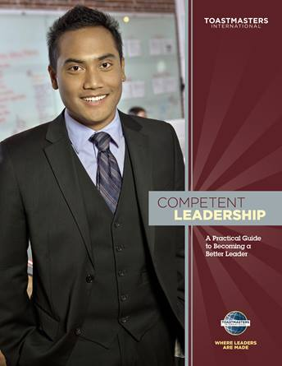
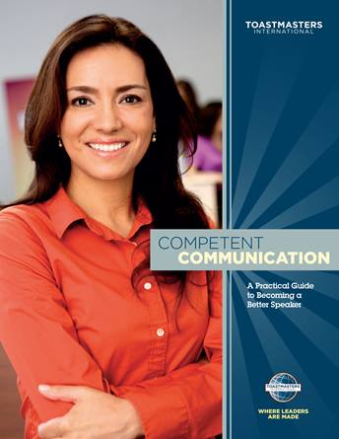
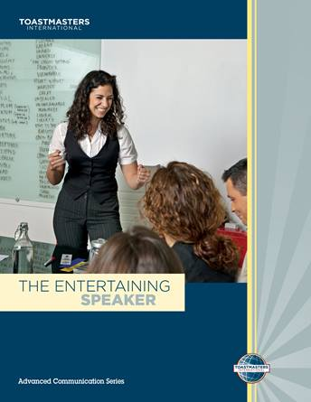
Current Program Chart to DTM
Club Officer+
District Officer Sponsor/Mentor/Coach HPL
DTM
Speechcraft,
YLP, et al
Educ.

Slide 6
Pathways Chart to DTM
Club Officer-12 mo
District Officer
Club Mentor or Club Coach
Club Sponsor or Speechcraft or Youth Leadership Program
New Member
DTM PROJECT
DTM

Slide 7
Two Paths, Five Levels Each
Mostly Communications
Communications & Leadership

Slide 8
Ten Paths Available
Dynamic Leadership
Effective Coaching
Innovative Planning
Leadership Development
Motivational Strategies
Persuasive Influence
Presentation Mastery
Strategic Relationships
Team Collaboration
Visionary Communication

Slide 9
Level 1: Mastering Fundamentals Same for all Paths
Ice Breaker (1 speech)
Evaluation and Feedback (2 speech + 1 eval)
Researching and Presenting (1 speech)
Three Projects, Four Speeches, Five Meetings
Members earn first award in just five meetings !

Slide 10
Level 2: Learning Your Style
Presentation Mastery
Innovative Planning
Understanding Your Communications Style
Effective Body Language
Introduction to Toastmasters Mentoring
Understanding Your Leadership Style
Connect with Your Audience
Introduction to Toastmasters Mentoring

Slide 11
Level 3: Increasing Knowledge
Presentation Mastery
Innovative Planning
Required: Persuasive Speaking
Required: Present a Proposal
Electives –both paths (choose 2)
Deliver Social Speeches
Focus on the Positive
Using Presentation Software
Inspire Your Audience
Connect with Storytelling
Prepare for an Interview
Connect with Your Audience
Creating Effective Visual Aids
Understanding Vocal Variety
Using Descriptive Language
Active Listening
Effective Body Language
Make Connections Through Networking

Slide 12
Level 4: Building Skills
Presentation Mastery
Innovative Planning
Required: Managing a Difficult Audience
Required: Manage Projects Successfully
Electives –both paths (choose 1)
Create a Podcast
Manage Online Meetings
Building a Social Media Presence
Question-and-Answer Session
Write a Compelling Blog
Public Relations Strategies
Manage Projects Successfully
Managing a Difficult Audience

Slide 13
Level 5: Demonstrating Expertise
Presentation Mastery
Innovative Planning
Required:
Prepare to Speak Professionally
Reflect on Your Path
Required:
High Performance Leadership
Reflect on Your Path
Electives –both paths (choose 1)
Leading in Your Volunteer Organization
Lessons Learned
Ethical Leadership
Prepare to Speak Professionally
Moderate a Panel Discussion
High Performance Leadership

Slide 14
Perspective Pathways is new, but based on familiar concepts and projects
Current program
Recognition earned for each of 7 awards plus DTM
Advanced manuals focus on six areas, five speeches each
Separate Communications and Leadership Tracks
Expires in 3 years
Pathways
Recognition earned for each of 10 levels plus DTM
Pick from 50 projects, Many choices, More to come
Integrated Communications and Leadership Learning
New, long-term program

Slide 16
Pathways in Action - Earning Awards
Today
Pathways
Member can work on multiple manuals concurrently
Works on projects in any order, any manual
Can see details of all manual projects before starting
Tracks own progress in manuals
Brings completed manuals to VPE for award
VPE submits award in Club Central
Member can work on multiple paths concurrently
Levels must be done in order within each path
Cannot see details of projects in the next level in a path
Record every project completion in Base Camp (excl. print paths)
Marks level “Completed” in Base Camp
VPE gets notification, approves completion, member → next level
VPE submits Level award in Club Central

Slide 17
Roll up
Help Newer Members
Faster Recognition for Accomplishments
Pick and choose projects
Instead of 5 per advanced manual
Based on current program projects
Simpler structure, easier to understand
It’s the new program, help new members

